Slide 1

KURUKSHETRA 2.0​
DisruptionOps
HACKFEST 2026
• PS20
• Agentic Disaster Relief & Emergency Resource Coordinator
• Agentic Ai
• KH131
• Kala Dhua
MIT ACSC • ALANDI, PUNE

Slide 2
Kala Dhua
SLIDE 02 · PROBLEM
The Problem Is Not the Forecast. It Is the Allocation.
When a disaster hits, five zones need help at once. There are never enough boats, pumps, ambulances or teams for all five — and the picture changes every few minutes.
Zone A
Zone B
Zone C
Zone D
Zone E
12 stranded · needs boats
Road cut · needs earthmover
Waterlogged · needs pumps
Shelter full · needs transport
Supplies low · needs trucks
SEVERITY 5
SEVERITY 4
SEVERITY 3
SEVERITY 4
SEVERITY 2
Five zones. Twenty-three free units. Who gets what, and who decides?
HOW IT IS COORDINATED TODAY
WHAT THAT COSTS
Phone calls
Duplicated effort
between agencies that each hold part of the picture
the same street cleared twice, the next one not at all
Two units, one incident
Slow decisions
while a third zone gets nothing at all
minutes lost per zone, multiplied across a city
No shared availability
Misdirected units
so nobody can optimise across the zones
sent down a road a crew already reported blocked
Nothing written down
No learning
re-planned in a head, unreviewable afterwards
the next disaster starts from the same blank sheet
02
MIT ACSC • ALANDI, PUNE

Slide 3
Kala Dhua
SLIDE 03 · BEFORE AND AFTER
One New Report, and Everything Re-plans
This is the demo PS20 asks for, and the single hardest thing in the problem: staying correct while the facts move.
MANUAL COORDINATION
DISRUPTIONOPS
Zone A reports 12 people stranded.
09:12
Parsed, trust-scored, clustered → severity 5. The two nearest water-rescue boats are assigned.
Officer calls fire brigade. Two boats dispatched.
09:14
Already done, two minutes ago.
Zone D reports a shelter at capacity.
09:19
Re-plan: a bus is re-tasked, the cost of the switch weighed first.
A second agency, unaware, also sends a boat to Zone A.
09:21
Second agency request matched to the open incident. Duplicate blocked.
Zone C reports rising water. No unit is free.
09:26
No free pump. The shortfall is raised to the officer, not hidden.
Crew radios that the Zone A road is blocked. Nobody re-plans.
09:31
Road removed from the graph. Route re-solved.
Three units on one incident. Two zones waiting. Nothing written down.
Every step recorded with the event that caused it. Re-plan: under two seconds.
03
MIT ACSC • ALANDI, PUNE

Slide 4
Kala Dhua
SLIDE 04 · SOLUTION
A Coordinator, Not a Dashboard
Agents that read every report, work out what each zone needs, solve the allocation under real constraints, and re-solve the moment anything changes.
REQ 01
REQ 02
REQ 03
REQ 04
REQ 05
Zone reporting
Resource inventory
Needs assessment
Allocation agent
Inter-agency
5 channels, 1 path
93 units, 9 kinds
capability per category
OR-Tools CP-SAT
request · accept · record
REQ 06
REQ 07
REQ 08
REQ 09
REQ 10
Dynamic re-allocation
Severity scoring
Duplicate detection
Console + Copilot
Audit log
with switching cost
corroboration-lifted
reports and dispatch
15 screens · 19 tools
database-enforced
All ten core requirements are demonstrable on the deployed system.
WHAT MAKES IT DIFFERENT
— The model never produces a number. Needs come from the taxonomy, allocation from the solver, authority from a cited clause. Remove the AI entirely and the system still runs — no competitor demo can say that.
— Re-planning carries a switching cost, so crews are re-tasked only when the gain beats the disruption. That is the difference between re-allocation and thrashing.
— One hazard-agnostic contract: flood, heat, air, fire and seismic share one codebase. A new disaster type is configuration, not a new product.
04
MIT ACSC • ALANDI, PUNE

Slide 5
Kala Dhua
SLIDE 05 · COMPETITOR ANALYSIS
Where Everyone Else Stops
Nobody here is bad at their job. Each solves one slice of PS20, and the slices do not meet.
Reports from zones
Models needs
Allocates units
Re-allocates live
Detects duplicates
Audit trail
IMD / CWC / NDMA
forecast agencies
●
—
—
—
—
—
Sachet / CAP alerting
broadcast
●
—
—
—
—
—
Everbridge / Esri EOC
commercial suites
●
●
—
—
—
●
Spreadsheets + phone
what is used today
●
—
●
—
—
—
DisruptionOps
this system
●
●
●
●
●
●
Against nearest-first, five seeds at a third of the fleet: 7% fewer demands uncovered, 4.2 min to commit a unit against 10.7.
05
MIT ACSC • ALANDI, PUNE

Slide 6
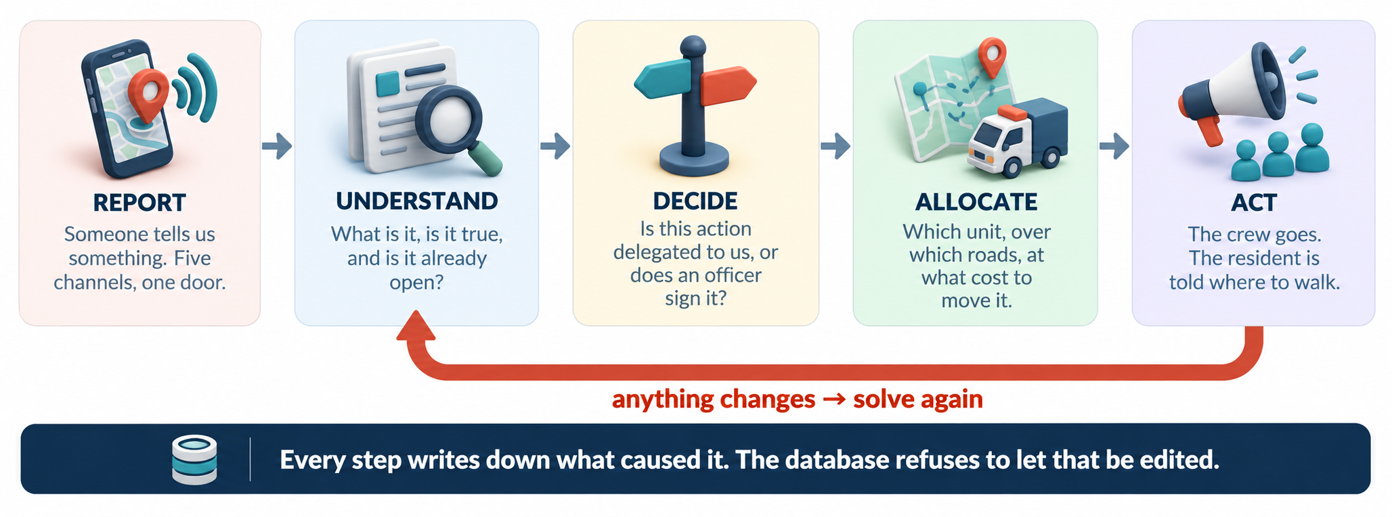
How It Is Built
SLIDE 06 · TECHNICAL APPROACH
A report enters at the top and a crew is moving at the bottom. Every step writes down why, and the two arrows back into the solver are what make it a loop.

Slide 7
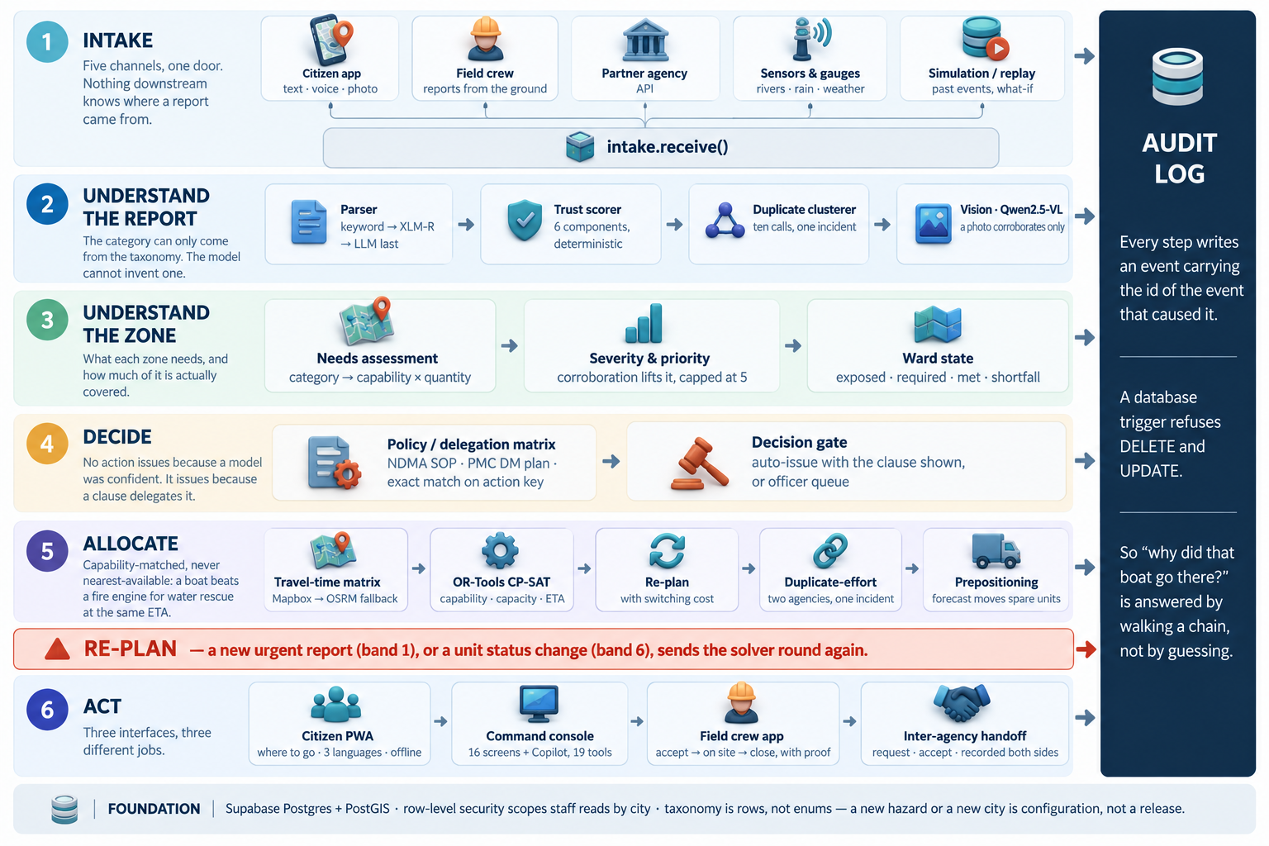
How It Is Built Detailed
SLIDE 06 · TECHNICAL APPROACH
A report enters at the top and a crew is moving at the bottom. Every step writes down why, and the two arrows back into the solver are what make it a loop.

Slide 8
Kala Dhua
SLIDE 07 · FEASIBILITY & IMPACT
Does It Work, and Does It Matter?
−7%
demands left uncovered, vs nearest-first
4.2 min
to commit a unit, against 10.7
+9%
arrival p90 — what re-tasking costs
10 / 10
PS20 requirements demonstrable
EVERY RISK, AND THE ANSWER
WHAT IT CHANGES
Network dies
Sent once
reports queue on the phone; the app opens offline
to the right zone, over roads that are open
A model is confidently wrong
Shortfalls surfaced
no model produces a number
to an officer, instead of silently absorbed
Load during an event
Recorded permanently
single-flight caching keyed on position
every action, every clause, every override
Cost
A new city is configuration
every live feed is keyless or free-tier
not a procurement round
AI / ML
Learned: Gamma-Poisson recurrence per zone from our own incident record · XLM-RoBERTa zero-shot for report text · Qwen2.5-VL for report photos · GloFAS v4.
Deterministic on purpose: trust scoring, clustering, the gate and the allocator. No labelled data exists, an officer must audit them, and they must run offline.
07
MIT ACSC • ALANDI, PUNE

Slide 9
Kala Dhua
SLIDE 08 · RESEARCH & REFERENCES
What We Read, and What We Used
RESEARCH CONDUCTED
NDMA Guidelines on Management of Urban Flooding (2010) and the PMC Disaster Management Plan , the source of every delegation clause the system cites.
OR-Tools CP-SAT literature on dispatch under scarcity.
GloFAS v4 (Copernicus) and Google Flood Hub (Nature, 2024).
Sphere Handbook minimum standards for relief quantities.
REFERENCES / SOURCES
open-meteo.com — forecast, flood and air APIs, keyless
ndma.gov.in — urban flooding guidelines
pmc.gov.in — Pune disaster management plan
developers.google.com/optimization — OR-Tools CP-SAT
docs.mapbox.com — Directions and Map GL
supabase.com/docs — Postgres, PostGIS, RLS, Realtime
GITHUB REPOSITORY
github.com/officialayush23/DisruptionOps
Public — migrations, the vision contract, and the dispatch benchmark harness are all in the repo.
Every source is open access or a public API. Nothing here depends on a licence we could lose.
08
MIT ACSC • ALANDI, PUNE

Slide 10
Kala Dhua
SLIDE 09 · BUILT WITH
What Is Built, and What It Is Built With
CITIZEN PWA
COMMAND CONSOLE
Voice, photo, and a live route
16 screens, and a Copilot with 19 tools
3 languages · offline outbox · redraws as roads close
ask · explain · simulate · propose through the gate
FIELD CREW APP
THE SOLVER
Accept → on site → close, with proof
OR-Tools CP-SAT, re-run as the world moves
a blocked road re-plans the city in seconds
capability match · switching cost · duplicate-effort
RELIEF LOGISTICS
BUILT WITH
78 facilities, stock and occupancy modelled
React · FastAPI · Supabase Postgres + PostGIS
a full shelter raises an incident like any other
Gemini · XLM-R · Qwen2.5-VL — prose, never a decision
09
MIT ACSC • ALANDI, PUNE

Slide 11
Kala Dhua
SLIDE 10 · DEMO
See It Running
LIVE DEMO: https://distro-ruddy.vercel.app/
CODE: https://github.com/officialayush23/DisruptionOps
AND THE COMMISSIONER CAN ASK IT
“What is happening?”
Live counts, worst ward first — not a canned summary.
“Why is Kothrud above Aundh?”
The priority, decomposed: exposure, severity, corroboration, shortfall.
“What are my options for the next three hours?”
Three strategies, each priced by the solver, each with what it costs.
“What if I move Pump 3 to Baner?”
Re-solves on a copy and shows the hole it leaves somewhere else.
Open /citizen — no login. Five zones, live severity,
and the route redraws as roads close.
Sign in for the command console and the crew app.
From a report to a unit moving — in one loop.
“Apply the second one.”
Through the delegation gate, never around it. Two clear, one waits.
Then a new report lands.
The plan changes, and the log already says which report caused it.
19 tools, three tiers: read, analyse, act. Only the last one may change the world.
10
MIT ACSC • ALANDI, PUNE

